Slide 1





Local Sustainability Hub
Notes:
Sustainability defines as addressing social economic and environmental priorities. HGG, a public-private partnership works at the nexus of these issues and serves as a global hub for sustainability.

Slide 2
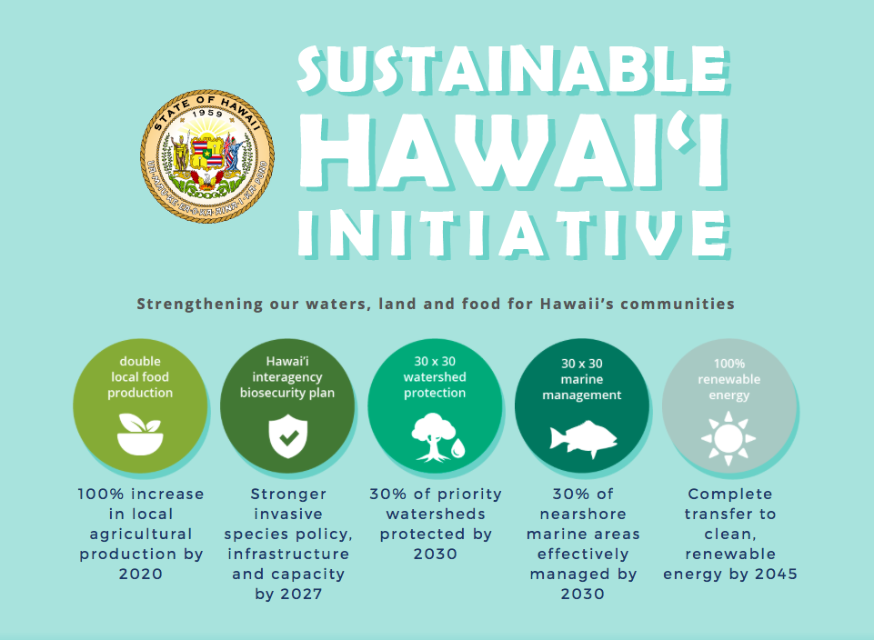




Hawai‘i’s Statewide Sustainability Commitment
Notes:
The Aloha+ Challenge has been recognized by the UN a localized model to advance the global Sustainable Development Goals. Unprecedented political

Slide 3
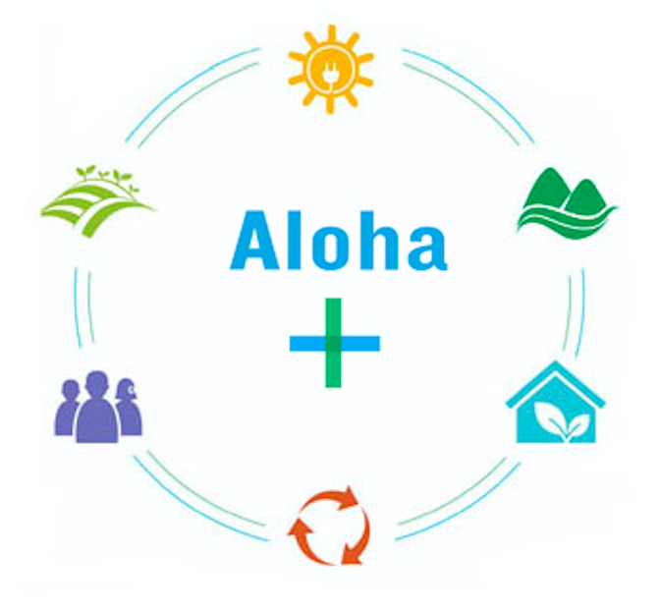
Economy
Environment
Society

Slide 4
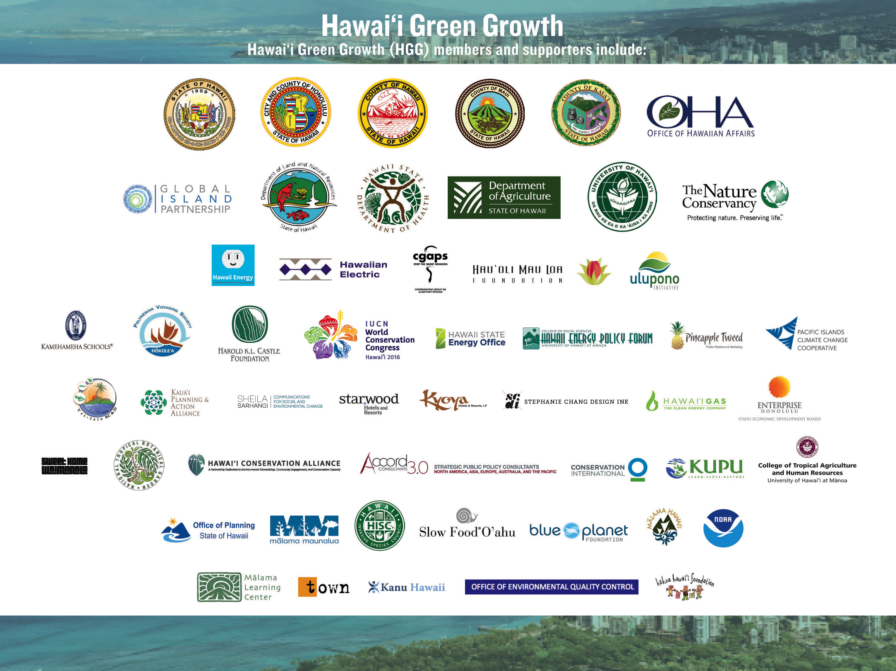

























Slide 5
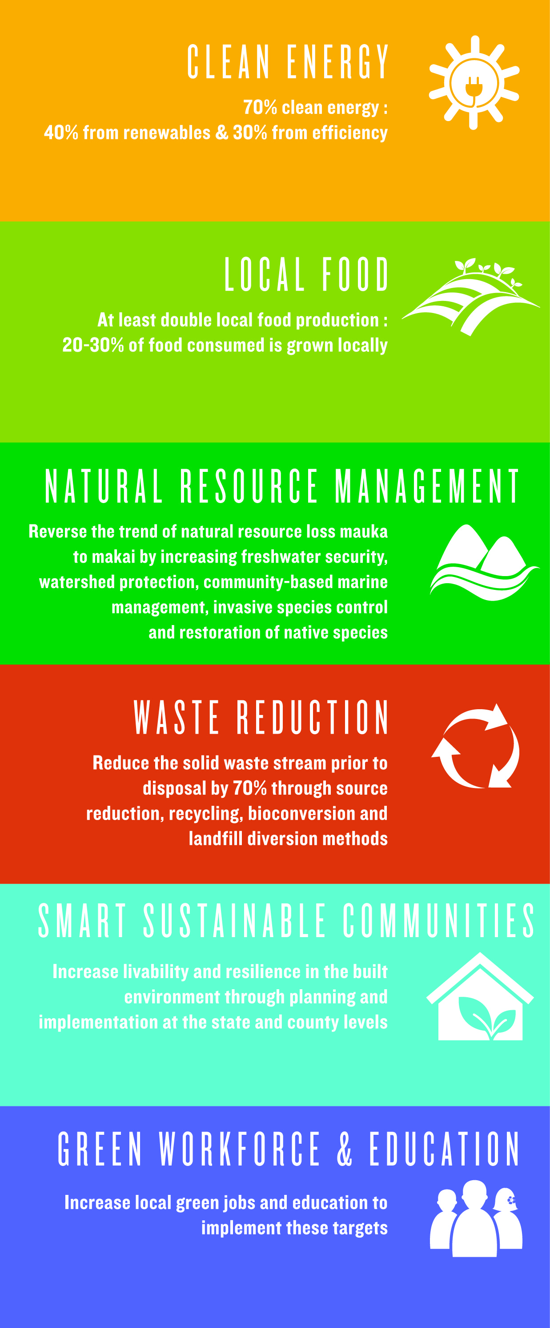
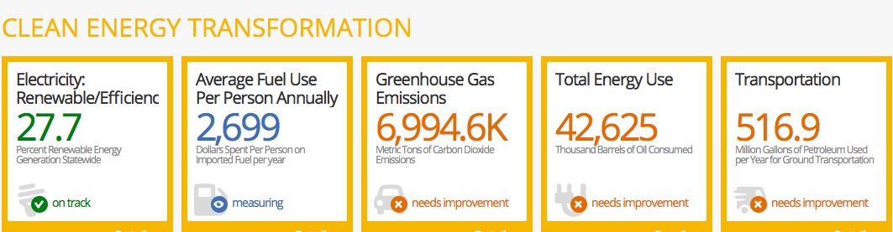
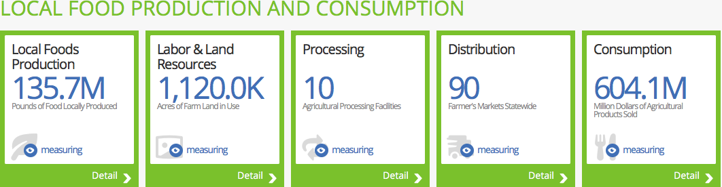
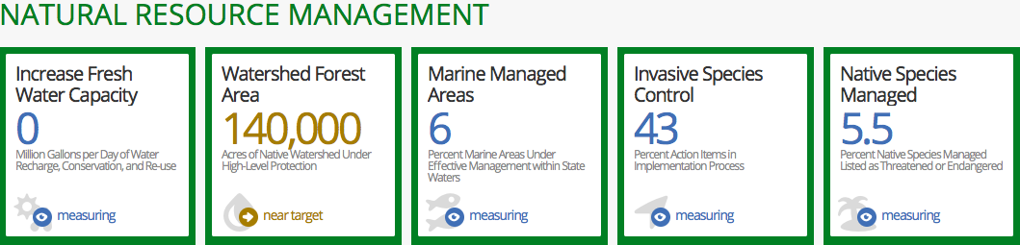
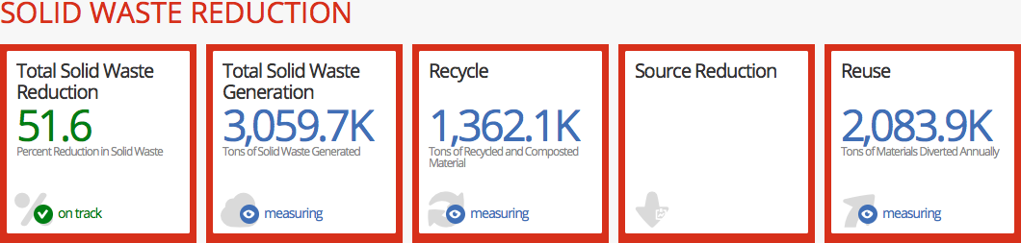
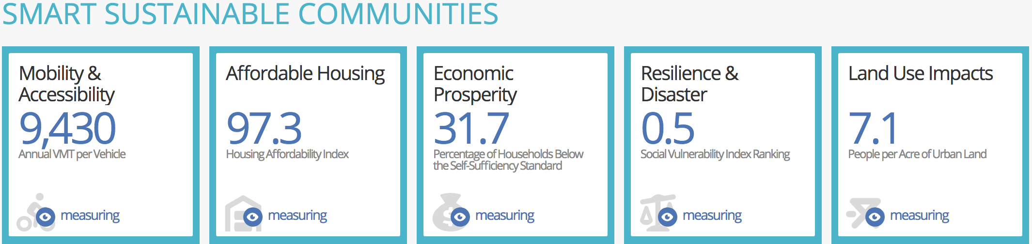
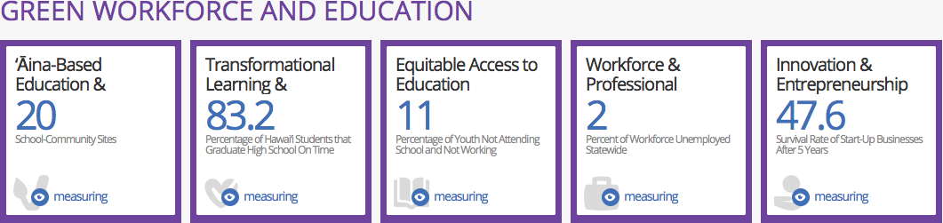

Slide 6
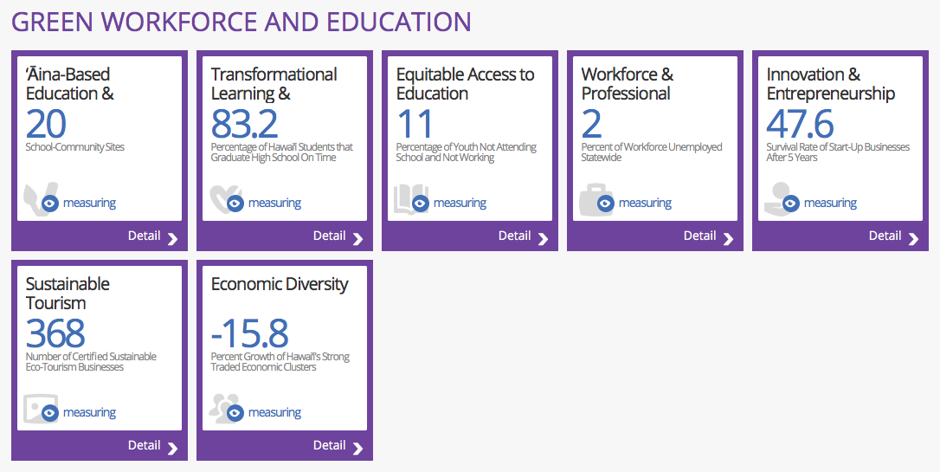
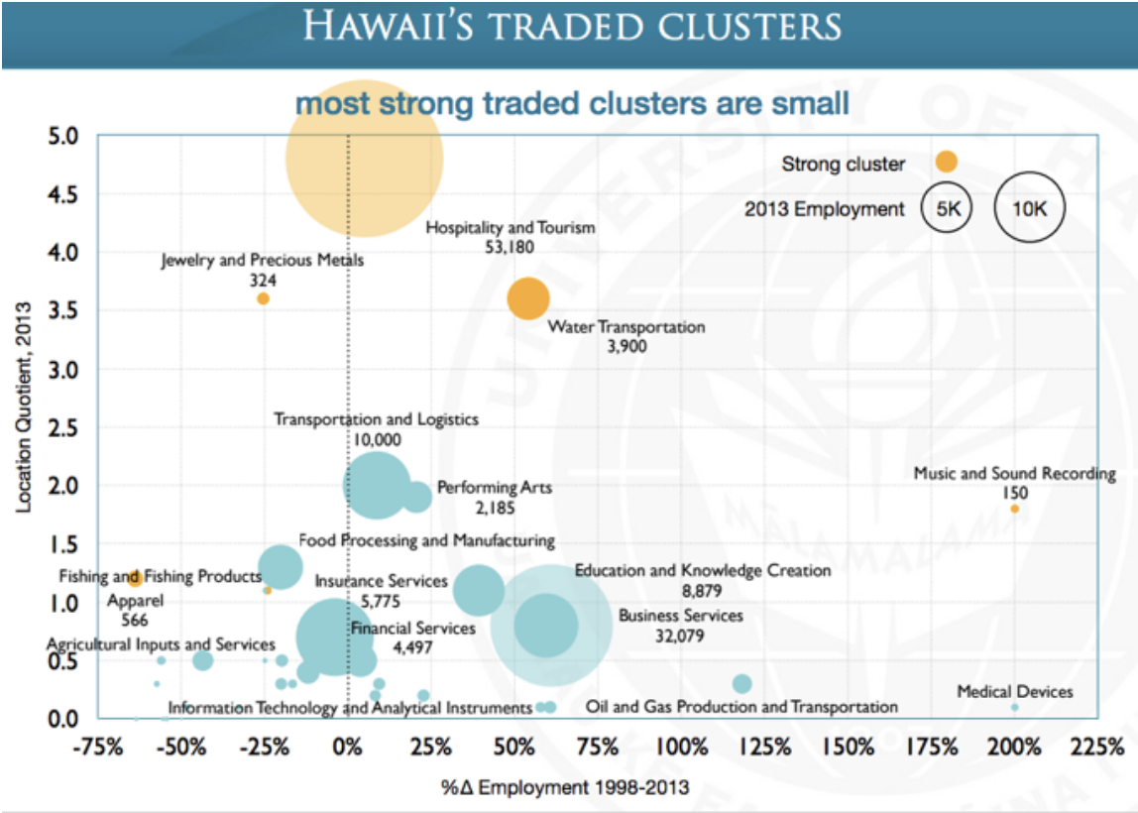
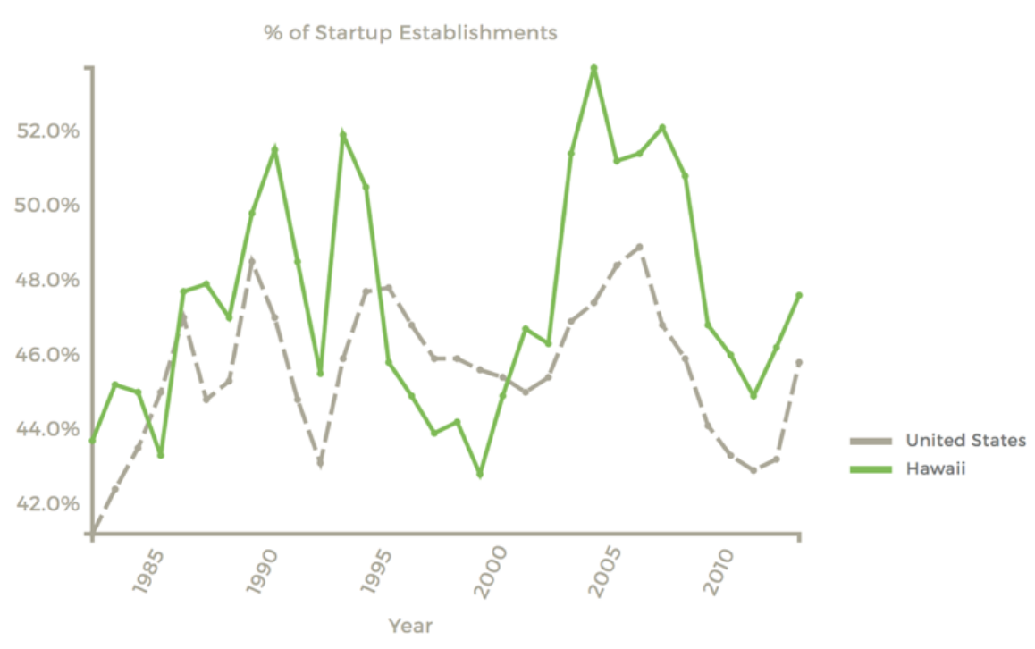
Notes:
Island economy, living lab for innovation
Education and knowledge creation – innovation – is on the leading edge of growing industries in Hawaiʻi

Slide 7
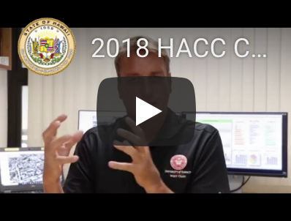
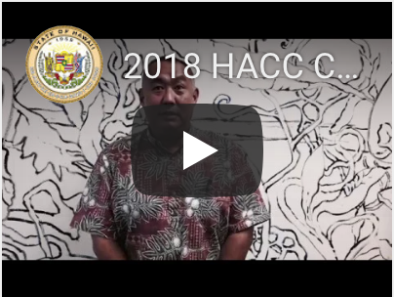
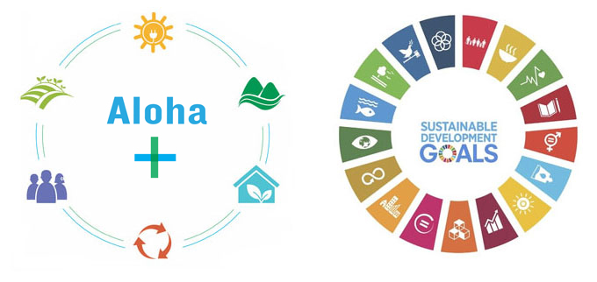
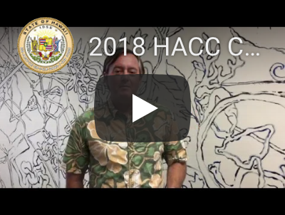
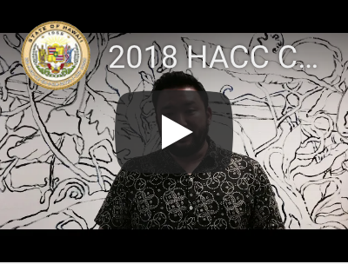

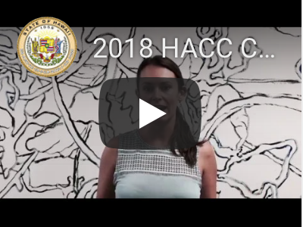
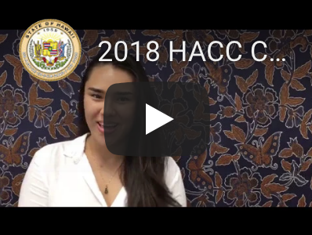
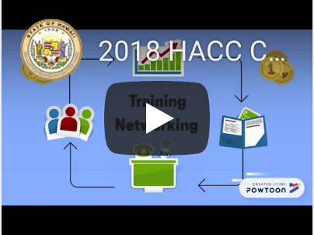
HACC Challenges
Advancing Aloha+ Challenge and UN SDGs
Solutions/Innovations

Slide 8

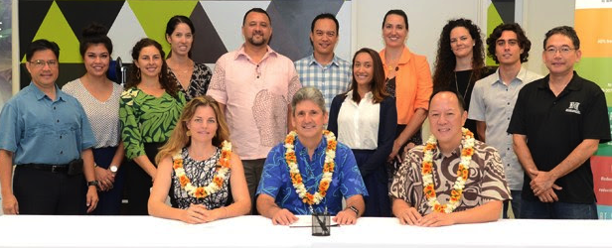
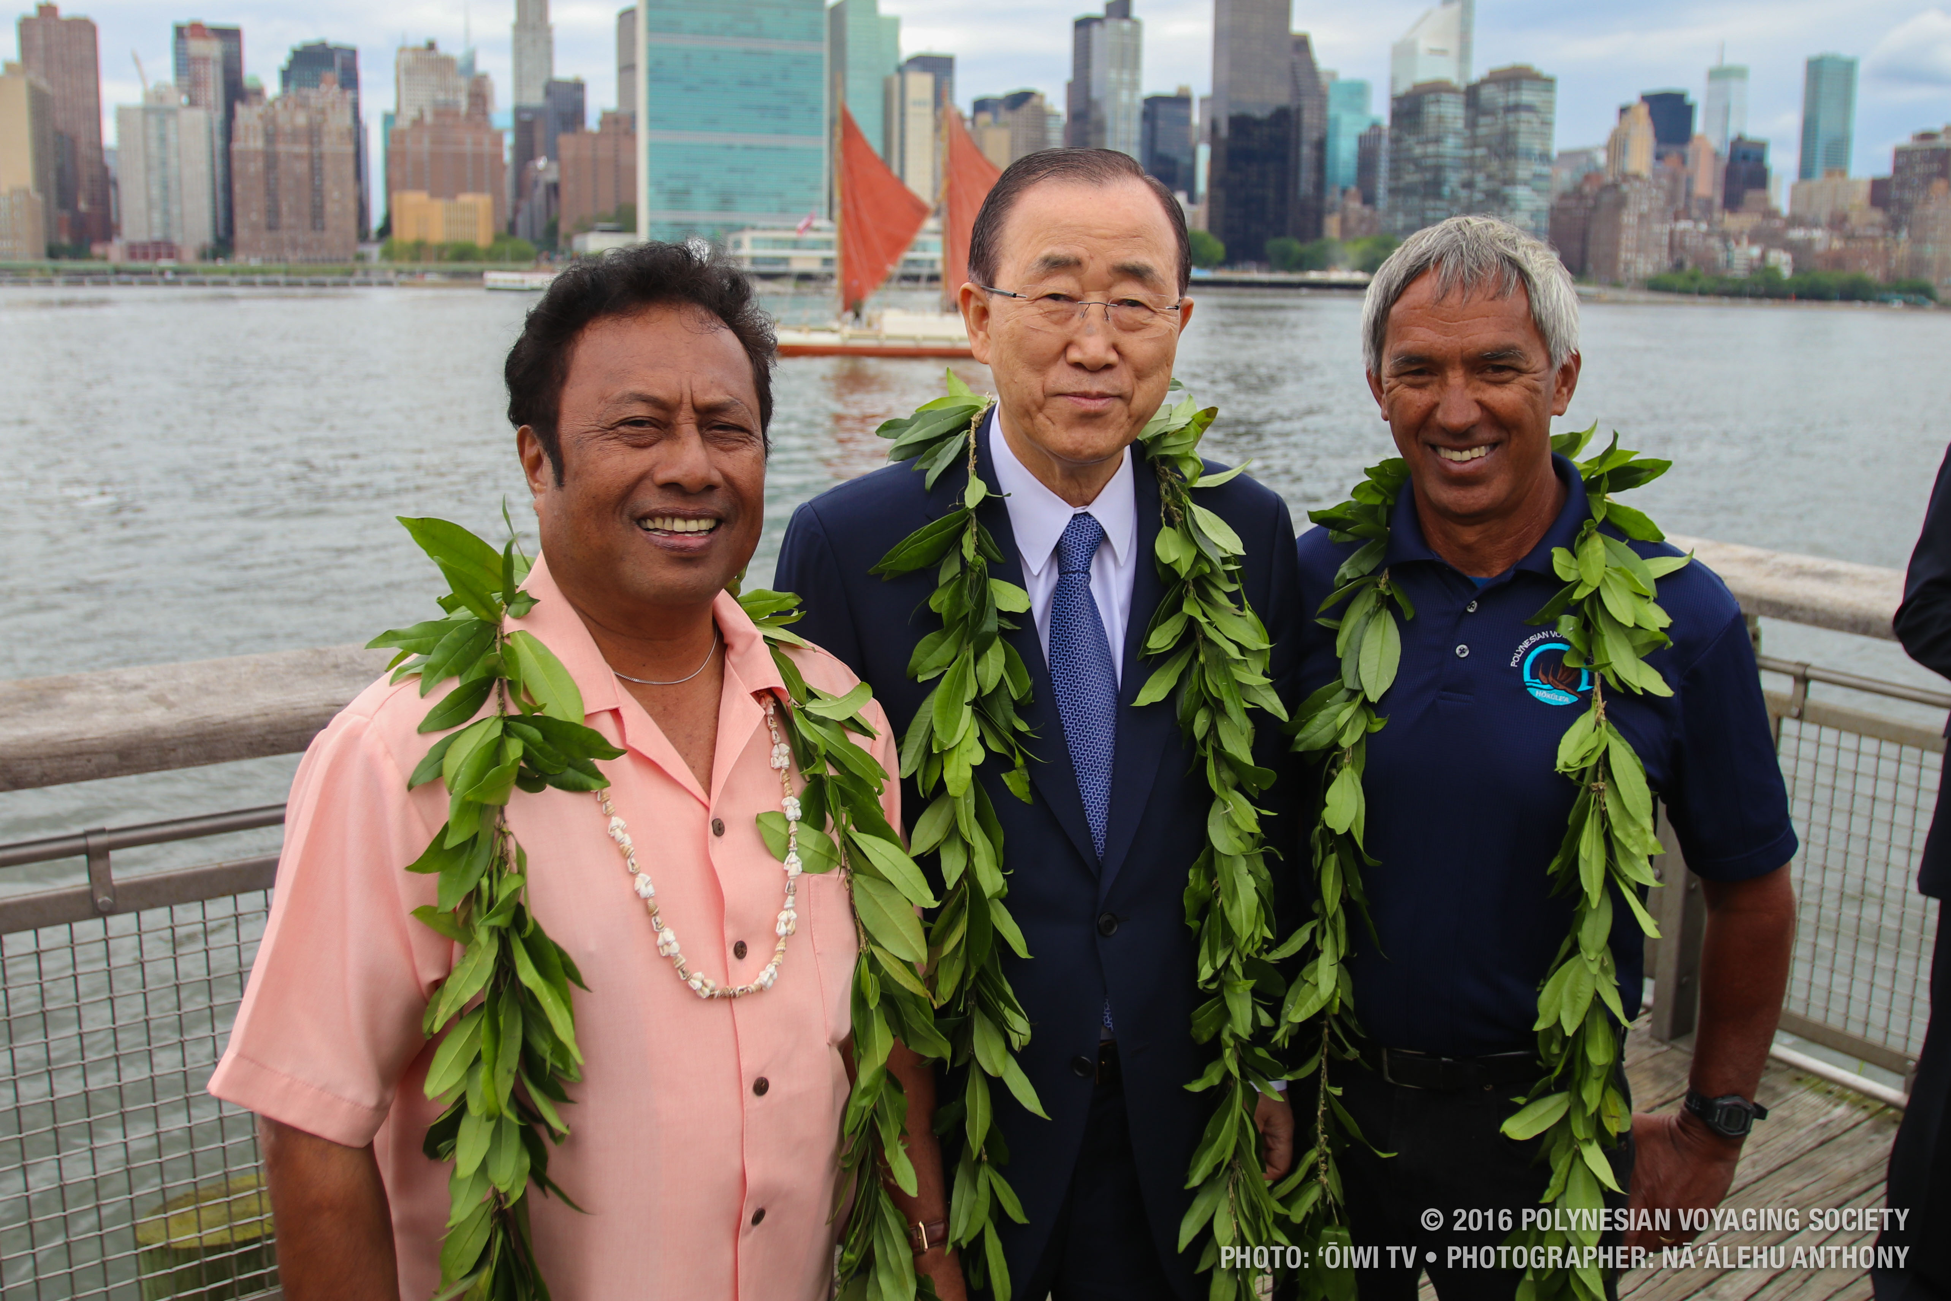


Partnerships to Scale Local Solutions

Slide 9

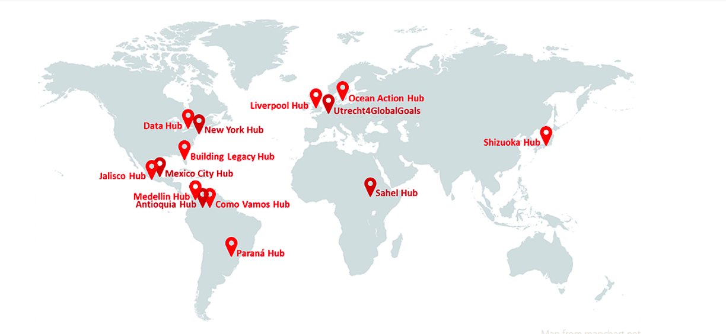

LOCAL HUBS FOR SUSTAINABILITY SOLUTIONS
Notes:
Global network of hubs – HGG has been invited by the UN Secretary General to be one of 15 global Local2030 Hubs for sustainability
Value of public—private partnerships

